Slide 1
A detailed overview of The MBG Migration Process

Slide 2
Agenda
Project Setup
Migration Pilot
Workload Planning
Workload Discovery
Project Backlogs
Migration
Landing Zone Assessment
Migration Tooling

Slide 3
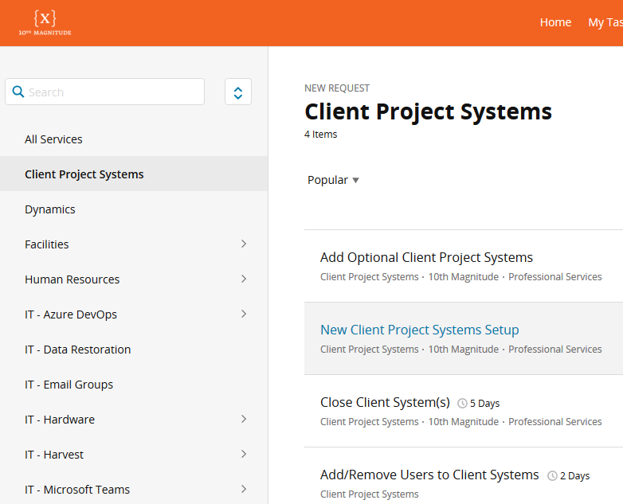
Project Setup – Getting Started
Client Onboarding
Initial communications
Request project platform and communications channels through the Service Desk (SAManage)
Azure DevOps Org for the client
Internal/External Teams channels
Sending the welcome kit
What is it?
Why its important
Setting up backlogs in DevOps from template
Handled by the project tech lead/architect

Slide 4
Project Setup – Collaboration
In addition to the project meetings, the CMC will setup and host a 1-2x week cadence to sync with the project leadership. This allows us to work through any issues internally, strategize, and plan capacity.
Teams channels
Use internal channels (naming convention INTERNAL-Clients/INTERNAL-ClientName) for internal collaboration, file sharing, file staging
Use external channels (naming convention Client-Name) for client collaboration and file sharing
Other internal channels to get questions quickly answered
10M – Solutions Development / ACM – Azure Cloud Migration

Slide 5
Workload Planning
Initial planning
Collaborative effort between DD/DM, tech lead/architect, migration analyst
Gathering workload and server lists from the client
Identifying priority and migration scheduling factors (blackout periods, etc) for workloads
Creating a draft plan, schedule, and adapting client workload/server lists into our templates
Ongoing effort for the duration of the project
Plans change due to various business factors

Slide 6
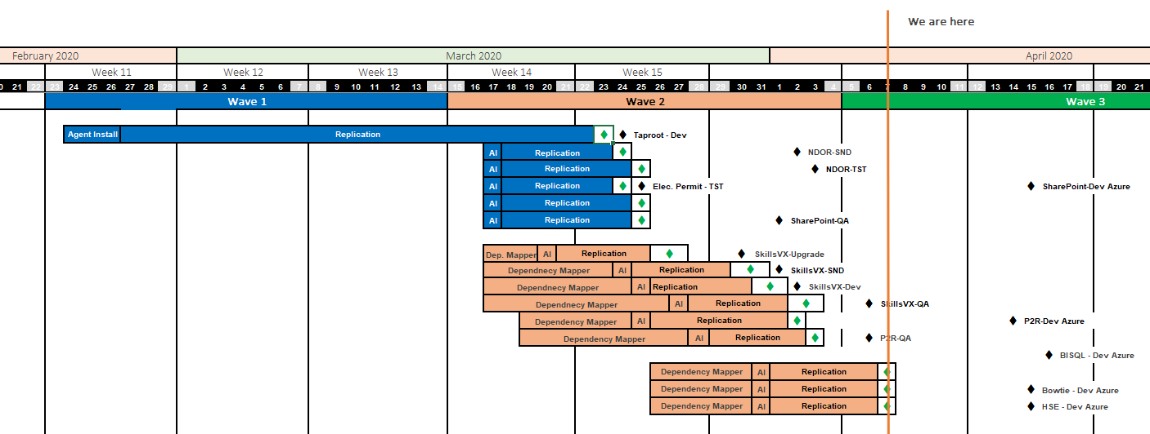
Workload Planning – Migration Schedule
Build a central visual migration schedule
First draft should be completed by the DD/DM ASAP
Should note the full lifecycle of each workload and milestones
Timeline for discovery > replication > failover test > cutover window > handoff
Easy to present where we are the project and what's coming as it progresses

Slide 7
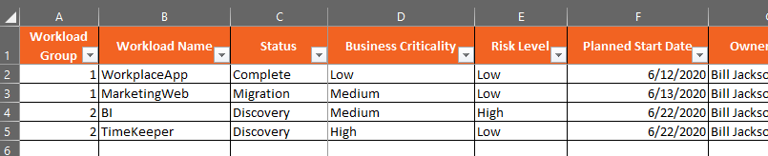
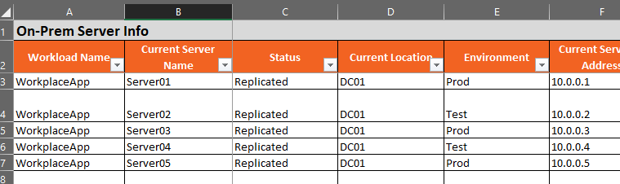
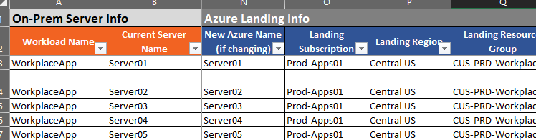
Workload Planning - Workload and Server Lists
Build a central workload and server list
There must be only one source of truth!
The project lead/architect takes what the customer has given us and puts that into our template format. We have templates for all of this.
These should be shared with the customer so they can modify as needed. Ideally these would be shared via the external client Teams channel.
The server list template details all information about what we migrated and its configuration. It is used as a deliverable when the migration is complete.

Slide 8
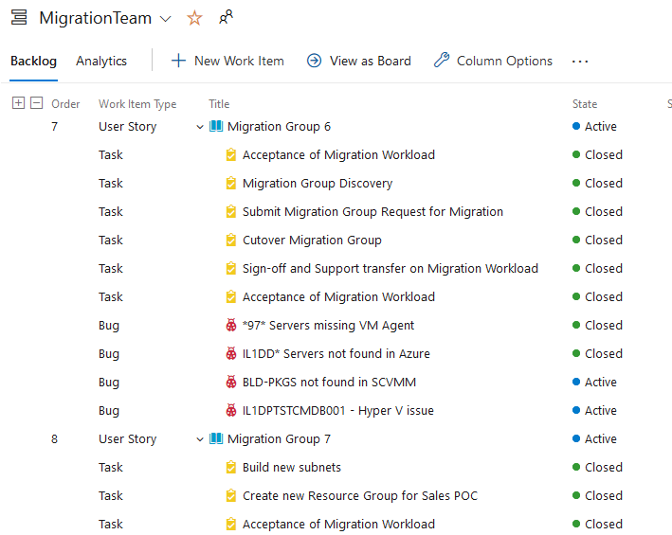
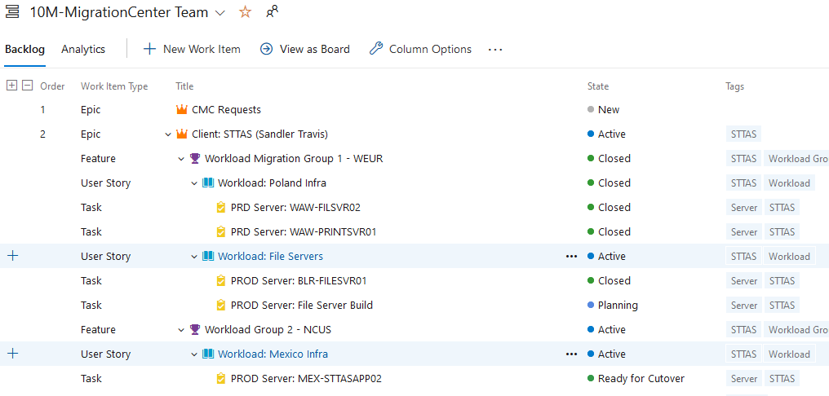
Project Backlog
Use Azure DevOps
Client DevOps Organization
Where the externally facing backlog lives
Created through a SAManage ticket
Managed by the project leadership team
Includes all stories/tasks related to LZ, remediation, migration setup, tracking blockers
Migration items are tracked at a high level – the workload level
External users should be added here and assigned tasks they own so they are tracked
Internal CMC DevOps Organization
Where the detailed CMC backlog lives
Managed by the CMC team
Very granular – tracked down to the server status level
Client Org Backlog
CMC Backlog

Slide 9
Migration Process
Landing Zone
Pilot
Discover
Migrate
Manage, Optimize, Secure
Evaluate current landing zone, or prepare the landing zone
Provide recommendations on any findings
Remediate where needed
Migration Tooling Setup
Migrate pilot server group or workload
Learn your environment
Establish build processes
Fine-tune processes
Begin Discovery
Prioritize migration workloads and align to phases
Workload analysis and architecture deep dive
Assess workload for cloud readiness
Identify migration strategy for each workload
Adjust initial migration plan, if needed
Schedule migration with the CMC
Replicate the workloads to the target Azure regions
Perform failover testing
Cutover the workloads to the target Azure regions
Perform post-failover setup for the workload and handoff to MBG’s Managed Services
Managed operations
Optimize migrated workloads
Secure migrated workloads
MBG & Customer Project Team
MBG Cloud Migration Center
MBG Managed Services
MBG Cloud Migration Center
Continuous Discovery and Migration

Slide 10
Landing Zone Assessment
Landing Zone
Pilot
Discover
Migrate
Manage, Optimize, Secure
Completed by the project tech lead/architect with support from the CMC
Verifies the client has a production ready environment suitable for migration
Allows us to provide recommendations on how to improve their current environment
Short remediation period to resolve the issues
Migration tooling setup should be happening in parallel
Completed before migration starts

Slide 11
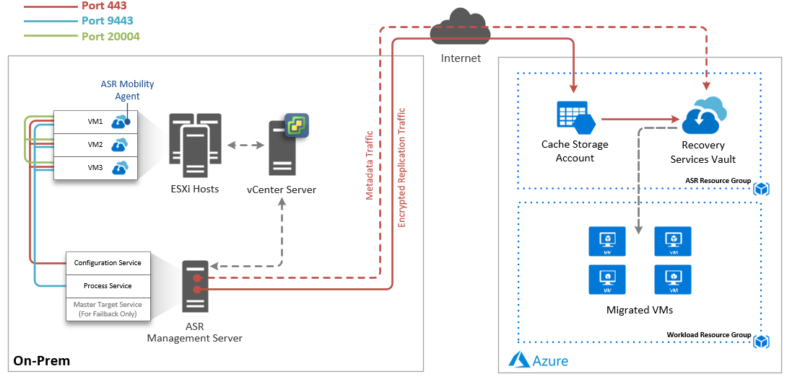
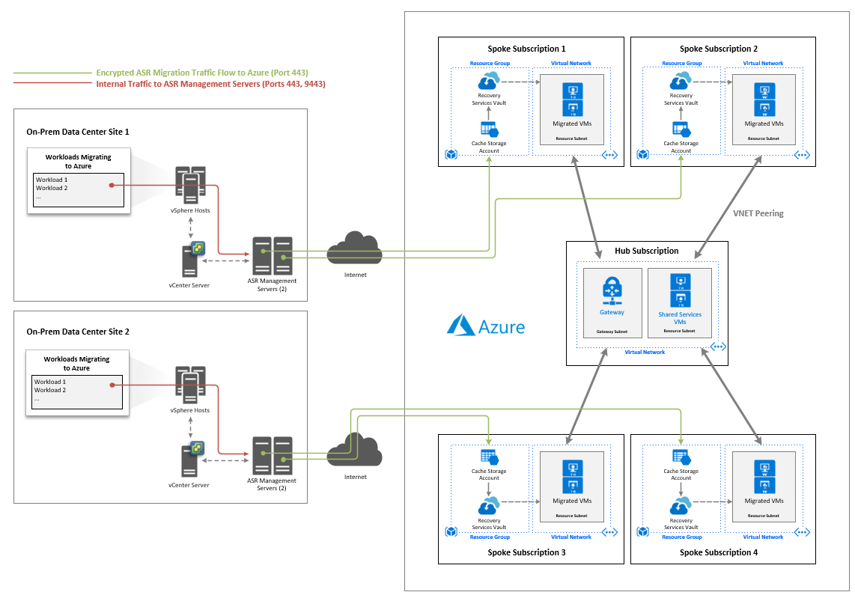
Migration Tooling Setup
Completed by the CMC with the support of the project tech lead/architect
Should happen in parallel with the landing zone assessment
Work with the client to review the info in the welcome kit and get a good understanding of their environment
Translate the information into an ASR topology
Deploy the Azure ASR components
Recovery Services vaults and cache storage accounts in each region
A failover testing environment in each region - IMPORTANT
Set up working sessions to assist the client deploy the on prem components

Slide 12
Migration Process
Landing Zone
Pilot
Discover
Migrate
Manage, Optimize, Secure
Evaluate current landing zone, or prepare the landing zone
Provide recommendations on any findings
Remediate where needed
Migration Tooling Setup (ASR)
Migrate pilot server group or workload
Learn your environment
Establish build processes
Fine-tune processes
Begin Discovery
Prioritize migration workloads and align to phases
Workload analysis and architecture deep dive
Assess workload for cloud readiness
Identify migration strategy for each workload
Adjust initial migration plan, if needed
Schedule migration with the CMC
Replicate the workloads to the target Azure regions
Perform failover testing
Cutover the workloads to the target Azure regions
Perform post-failover setup for the workload and handoff to 10th Magnitude’s Managed Services
Managed operations
Optimize migrated workloads
Secure migrated workloads
10M & Customer Project Team
10M Cloud Migration Center
10M Managed Services
10M Cloud Migration Center
Continuous Discovery and Migration

Slide 13

Continuous Discovery and Migration
Example Migration Cycle
Discovery
Meet with workload owners and stakeholders to gather information, dependencies, timeline and build a plan for migrating the workload or workload group.
Migration Group 1 - Pilot
Identify a low impact workload for tooling and process testing
Conduct a migration to demonstrate and fine tune tooling, process, plans
Start discovery for the next migration group
Migration Groups 2+
The 10M Migration Center will replicate and perform cutover on groups of workloads
Perform testing to verify the workload meets customer standards
Transition
Transition the workload to 10M Managed Services
Provide documentation
Repeat
Cycle through the process to quickly migrate groups of servers and workloads
Week 1
Week 2
Week 3
Week 4
Week 5+
Migration Leadership Team Sprint - 2 Weeks
Ongoing Work
Migration Leadership Team
Landing Zone Assessment and Preparation
Group 1 - Pilot Discovery
Group 2 Discovery
Group 3 Discovery
Group n
Discovery
Group 1 - Pilot Migration
Group 2 Migration
Group n
Migration
Migration Center
Sprint - 1 Week
Cloud Migration Center
Managed Services

Slide 14
Migration Pilot
Landing Zone
Pilot
Discover
Migrate
Manage, Optimize, Secure
An initial small migration of a non-critical or test workload
Validate tooling
Validate process
Validate automations
Verify the servers will boot and perform as expected in Azure
Allow the opportunity to collaboratively tune the migration process or resolve any fundamental problems that are discovered

Slide 15
Workload Discovery
Landing Zone
Pilot
Discover
Migrate
Manage, Optimize, Secure
Templatized information gathering about a workload targeted for migration
Process
Send discovery template to workload owners to fill out and provide any additional supporting information like diagrams, etc
10M technical team will review and work with the project team to schedule a session to discuss with application owner and SMEs. For complex workloads, multiple sessions may be needed.
Technical team will translate findings into a workload migration backlog and input into the workload migration template

Slide 16
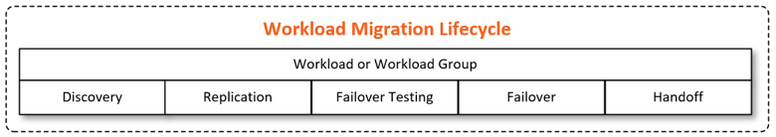
Migration – Getting Started
Landing Zone
Pilot
Discover
Migrate
Manage, Optimize, Secure
Pilot is complete – tooling and process verified and communicated
Workload owners are good to proceed
Discovery for the workload or group is complete, no outstanding questions or concerns
All prerequisites are known

Slide 17
Migration – Planning
Landing Zone
Pilot
Discover
Migrate
Manage, Optimize, Secure
Planning a workload migration
Collaborative effort between the Migration Analyst, Architect, DD/DM, and the CMC
A migration worksheet needs to be completed for each workload or workload group (some exceptions for simple workloads)
Info necessary and captured in the migration worksheet from information gathered in the discovery
Workload owner, stakeholders, SMEs, any resources that will be involved in the process
Tagging for the workload
Pre-failover checklist - details any prerequisite setup activities
Failover checklist - details all coordinated activities that may need to happen during the cutover by both 10M and client teams
Post-failover checklist - details any items that need to be configured after the cutover (operations, handoff details, etc)
Ensure that we have backlog items created for any prerequisite activities so they are tracked.

Slide 18
Migration – Scheduling
Landing Zone
Pilot
Discover
Migrate
Manage, Optimize, Secure
Scheduling the migration with the CMC
Handled by the DD/DM
Need at least 1 week lead time for standard migrations. For after hours or weekend work, shoot for 2 weeks lead time
Ensure that we have enough time to complete any prerequisite activities before cutover
Use the CMC shared calendar to pick a good time and verify no conflicts (cmc-pool@10thmagnitdue.com)
Optional - a Teams call can by scheduled for the test failover if the client wants to be involved in the testing. Otherwise, failover testing is completed as the CMC has availability since it doesn’t affect the live workloads.
Schedule a Teams call for the cutover – make sure we have enough time to troubleshoot and fail back if necessary. Work with the CMC to estimate timeframe, generally a 4-6 hour window is good.
Some clients are good with NOT scheduling a call if the workload is not critical. In this case, we should still schedule the time on the CMC calendar, but the CMC will complete and then notify the DD/DM/Customer that the workload is ready for testing.
If the client is a Managed Services customer
Make sure their TAM is aware of the migration
Notify Ops of the incoming servers for awareness
Include Ops on the cutover invite for awareness and support if needed

Slide 19
Migration – Failover Testing
Landing Zone
Pilot
Discover
Migrate
Manage, Optimize, Secure
Failover Testing
The migrated virtual machines will be failed over into the isolated testing environment. The source on-premises machines are left online and not affected in any way.
Verifies the machine will boot in Azure. Helps us discover any problems and plan for remediations.
HAS LIMITATIONS – generally the isolated nature of the test environment doesn’t allow for FULL application testing. For example, Active Directory may not be available for testing authentication, or a connection back to a database may not work.

Slide 20
Migration – Cutover
Landing Zone
Pilot
Discover
Migrate
Manage, Optimize, Secure
Cutover
The migrated virtual machines will be failed over into the production Azure virtual machine. The source on-premises machines are shut down and locked by ASR (if permissions allow)
This should be a highly collaborative effort with the client. 10M will perform basic testing to verify the machines come up as expected in Azure and are accessible.
The client should perform their own validation and testing of the workload as well
10M will support the client in verifying the workload, but is generally not responsible for:
DNS reconfiguration/updates
Third-party firewall troubleshooting or configuration (we will support Azure firewall)
Application reconfiguration or testing
Once complete, the machines are treated as production and operations will be configured (monitoring, backups, DR, etc)

Slide 21
Migration – Handoff
Landing Zone
Pilot
Discover
Migrate
Manage, Optimize, Secure
Handoff
Happens ASAP after a migration since they are treated as production
Handoff the workload to the client's internal operations, or:
Handoff the workload to 10M Managed Services
Send email to the TAMs DL to generate an onboarding ticket
Work with the TAM and Ops teams to verify
Client signoff
After migration is complete, the DD/DM should verify the client is satisfied with the outcome and request formal written signoff from the workload and infrastructure owners
This is generally an email that we save in the project documents
Repeat the cycle for each workload or group!

Slide 22
Process Support
If you have any questions or suggestions about the process:
Reach out on the 10M Solutions Development / ACM – Azure Cloud Migration Teams channel
Email us at 10M-MigrationCenter@10thmagnitude.com
If you’re not getting what you need with the above options, contact Russ Henderson or Mark Hanson

